Slide 1




BOOK2MOVIE
BOOK INSPIRED MOVIE RECOMMENDER
J Component Review

Slide 2





INTRODUCTION
A book to movie recommendation system is a technology-driven tool that helps users discover films based on their favorite books or vice versa. It uses algorithms and data analysis to provide personalized suggestions, enhancing the user's experience by aligning with their reading and viewing preferences in an era where books and movies increasingly intersect.
In recent years, such recommendation systems have gained popularity due to the increasing convergence of the literary and film industries. With countless books being adapted into movies and TV series, and with the rise of streaming platforms, users now have more options than ever for consuming content.

Slide 3





AIM OF THE PROJECT
Enhancing User Experience: The system aims to improve the overall entertainment experience of users by providing them with personalized and relevant recommendations.
Promoting Cross-Media Exploration: Another aim is to encourage users to explore both the literary and cinematic worlds. By suggesting books related to movies they've enjoyed and vice versa, the system promotes cross-media engagement.

Slide 4

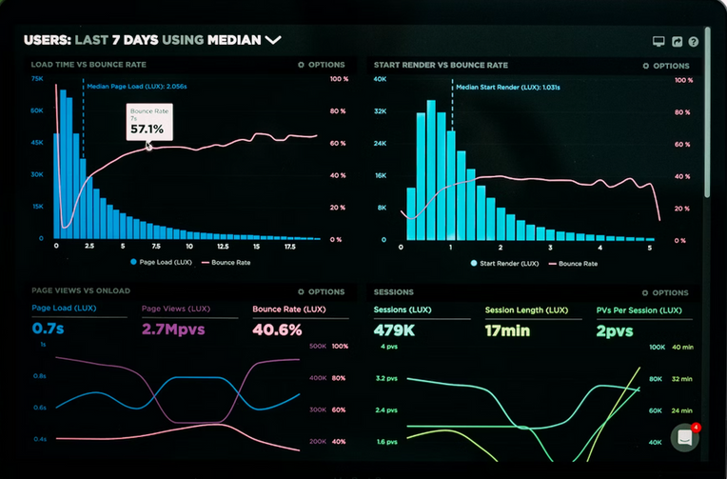
DATASET
We utilized Scrapy, a powerful web scraping framework, and Python as our scripting language. We also strictly adhered to ethical scraping practices and respected Amazon's terms of service throughout the project.
We tackled challenges related to data quality and size by implementing robust data cleaning and transformation procedures. This ensured that our dataset was both reliable and manageable.
The dataset we've compiled opens up possibilities for in-depth analysis and insights generation. It can be applied in various domains, including market research and product development.

Slide 5



PRIME VIDEO
We are extracting the movies and series data from the prime video data ice.
AMAZON KINDLE / GOODREADS
We are extracting the books data from the amazon kindle/ goodreads dataset

Slide 6
Ref No | Journal Name | Paper Name | Year | Authors | Model | Compared Algo | Parameters | Advantages | Disadvantages
1 | Springer Lecture Notes in Computer Science (ECIR 2024) | Large Language Models are Zero-Shot Rankers for Recommender Systems | 2024 | Yupeng Hou, Junjie Zhang, Zihan Lin, Hongyu Lu, Ruobing Xie, Julian McAuley, Wayne Xin Zhao | Large Language Models | Candidate Generation Models | Specially designed prompting and bootstrapping strategies | Zero-shot ranking capabilities, challenges with historical interaction order and biases | Bias by popularity and item positions in prompts
2 | Springer Complex & Intelligent Systems | Artificial intelligence in recommender systems | 2021 | Qian Zhang, Jie Lu, Yaochu Jin | AI methods | Computational Intelligence, Machine Learning, Fuzzy Techniques, Neural Networks, Deep Learning, Active Learning | Specially designed prompting and bootstrapping strategies | Reviews AI methods in RS, improves prediction accuracy, addresses data sparsity and cold start problems | Data sparsity and cold-start challenges
3 | Springer Recommender Systems Handbook | Recommender Systems: Techniques, Applications, and Challenges | 2021 | Francesco Ricci, Lior Rokach, Bracha Shapira | Hybrid | Association Rule Mining | Book-crossing, Amazon Review | Comprehensive overview of RS techniques and challenges, structured approach to understanding the field | Performance variation depending on dataset
4 | IEEE Transactions on Knowledge and Data Engineering | A Survey on Knowledge Graph-Based Recommender Systems | 2020 | Qingyu Guo, Fuzhen Zhuang, Chuan Qin, Hengshu Zhu, Xing Xie, Hui Xiong, Qing He | Knowledge Graph-based | Embedding-based, Connection-based, Propagation-based | Extensive experiments | Utilizes knowledge graphs to improve recommendation accuracy and explainability | Data sparsity and cold-start challenges
4 | Springer Neural Computing and Applications | Social movie recommender system based on deep autoencoder network using Twitter data | 2021 | Hossein Tahmasebi, Reza Ravanmehr, Rezvan Mohamadrezaei | Deep autoencoder network, collaborative and content-based filtering | MovieTweetings, Open Movie Database | Social influence, evaluation metrics | Improved accuracy over other methods | Bias by popularity and item positions in prompts
5 | Springer User Modeling and User-Adapted Interaction | Multistakeholder recommendation: Survey and research directions | 2020 | Himan Abdollahpouri, Gediminas Adomavicius, Robin Burke, Ido Guy, Dietmar Jannach, Toshihiro Kamishima, Jan Krasnodebski, Luiz Pizzato | Hybrid | Association Rule Mining | Ontology for user profiling | Explores multistakeholder perspectives in RS, considers fairness, balance, profitability | Limits in incorporating non-user-centric objectives, stakeholder concerns

Slide 7
Ref No | Journal Name | Paper Name | Year | Authors | Model | Compared Algo | Parameters | Advantages | Disadvantages
6 | IEEE | Book Recommendation System through content based and collaborative filtering method | 2016 | Praveena Mathew, Bincy Kuriakose, Vinayak Hegde | Hybrid | Content-based, Collaborative Filtering, Association Rule Mining | Extensive experiments | Combines multiple algorithms for effective book recommendations | Potential loss of diversity
7 | IEEE | A novel approach for book recommendation systems | 2016 | P Devika, R C Jisha, G P Sajeev | FPIntersect algorithm | Embedding-based, Connection-based, Propagation-based | Ontology for user profiling | Introduces FPIntersect algorithm for efficient pattern mining, validated through simulations | -
8 | IEEE | Hybrid attribute and personality based recommender system for book recommendation | 2017 | Adli Ihsan Hariadi, Dade Nurjanah | Hybrid | MSV-MSL method | Book-crossing, Amazon Review | Improves recommendation quality with user personality, tested on different datasets | Performance variation depending on dataset
9 | Elviser Procedia manufacturing | FUCL mining technique for book recommender system in library service | 2018 | Pijitra Jomsri | FUCL | Association Rule Mining | University library | Higher accuracy in library book recommendation, utilizes association rule mining | -
10 | Elviser Procedia Computer Science | Introducing Hybrid Technique for Optimization of Book Recommender System☆ | 2015 | Manisha Chandak, Sheetal Girase, Debajyoti Mukhopadhyay | Hybrid | Collaborative Filtering, Content-based, Demographic | Ontology for user profiling | Enhances system efficiency through hybrid technique, utilizes ontology for user profiling | Latency issues in traditional algorithms

Slide 8
Ref No | Journal Name | Paper Name | Year | Authors | Model | Compared Algo | Parameters | Advantages | Disadvantages
11 | IEEE | A profile- and community-driven book recommender system | 2015 | I. Petrović, P. Perković, I. Štajduhar | Hybrid | Embedding-based, Connection-based, Propagation-based | Book-crossing, Amazon Review | Integrates social network aspects into recommender system, encourages user engagement | Privacy Issues
12 | Springer Multimedia Tools and Applications | A comprehensive analysis on movie recommendation system employing collaborative filtering | 2021 | Urvish Thakker, Ruhi Patel, Manan Shah | Collaborative Filtering | Not specified | MovieLens dataset | Insight into CF approaches | Challenges in CF systems
13 | Elviser Expert Systems with Applications | GHRS: Graph-based hybrid recommendation system with application to movie recommendation | 2022 | Zahra Zamanzadeh Darban, Mohammad Hadi Valipour | Graph-based, Autoencoders | Basic and state-of-the-art methods | Various evaluation metrics, MovieLens dataset | Improved accuracy, cold-start solution | Potential loss of diversity
14 | Springer International Journal of System Assurance Engineering and Management | Comparative study of recommender system approaches and movie recommendation using collaborative filtering | 2021 | Taushif Anwar, V. Uma | Collaborative Filtering, SVD++, K-NN, SVD, Co-clustering | RMSE, MAE | MovieLens 100K dataset, error metrics | Lower error rates, overcomes cold start and data sparsity | Challenges in CF systems
15 | Springer International Journal of Information Technology | Multimodal trust based recommender system with machine learning approaches for movie recommendation | 2021 | Sasmita Subhadarsinee Choudhury, Sachi Nandan Mohanty, Alok Kumar Jagadev | DNN, SVD, DNN with Trust | MSE value | Trust matrix, user preferences | High accuracy, suitable for movie recommendations | Data sparsity and cold-start challenges

Slide 9
Ref No | Journal Name | Paper Name | Year | Authors | Model | Compared Algo | Parameters | Advantages | Disadvantages
16 | IEEE Transactions on Computational Social Systems | Movie Recommendation System Using Sentiment Analysis From Microblogging Data | 2020 | Sudhanshu Kumar, Kanjar De, Partha Pratim Roy | Hybrid RS (CF + CBF), sentiment analysis | Not specified | Public database, sentiment analysis | Promising experimental results | Performance variation depending on dataset
17 | Springer Neural Computing and Applications | Social movie recommender system based on deep autoencoder network using Twitter data | 2021 | Hossein Tahmasebi, Reza Ravanmehr, Rezvan Mohamadrezaei | Deep autoencoder network, collaborative and content-based filtering | MovieTweetings, Open Movie Database | Social influence, evaluation metrics | Improved accuracy over other methods | Performance variation depending on dataset
18 | Springer National Academy Science Letters | Movie Recommendation System Using K-Nearest Neighbors Variants | 2022 | Sonu Airen, Jitendra Agrawal | K-NN variants (cosine, msd, pearson, pearson baseline) | Concordant Pairs, MAE, MSE, RMSE, precision@k, recall@k | MovieLens dataset | Real-life application, customizable plugin | Potential loss of diversity
19 | Springer Proceedings of First International Conference on Computing, Communications, and Cyber-Security | Multilingual Opinion Mining Movie Recommendation System Using RNN | 2020 | Tarana Singh, Anand Nayyar, Arun Solanki | RNN | Sentiment classification, real-time multilingual tweets | Twitter API, Google Translate API | High accuracy in sentiment analysis | Bias by popularity and item positions in prompts
20 | Springer Mobile Networks and Applications | Movie Recommendation System for Educational Purposes Based on Field-Aware Factorization Machine | 2021 | Fei Lang, Lili Liang, Kai Huang, Teng Chen, Suxia Zhu | Field-Aware Factorization Machine | RMSE | MovieLens dataset | Effective for educational contexts | Performance variation depending on dataset

Slide 10
Ref No | Journal Name | Paper Name | Year | Authors | Model | Compared Algo | Parameters | Advantages | Disadvantages
21 | IEEE | Movie Recommender System Using Collaborative Filtering | 2021 | Harsh Khatter, Nishtha Goel, Naina Gupta, Muskan Gulati | Cosine Similarity, Sentiment Analysis | Not specified | TMDB dataset, sentiment analysis | Accurate and personalized recommendations | Data sparsity and cold-start challenges
22 | IEEE | Movie Recommendation System Using NLP Tools | 2020 | Nimish Kapoor, Saurav Vishal, Krishnaveni K. S. | SVM | Sentiment analysis | TMDB dataset | Incorporates user reviews for better recommendations | Potential loss of diversity
24 | Springer National Academy Science Letters | Movie Recommendation System Using K-Nearest Neighbors Variants | 2022 | Sonu Airen, Jitendra Agrawal | K-NN variants (cosine, msd, pearson, pearson baseline) | Concordant Pairs, MAE, MSE, RMSE, precision@k, recall@k | MovieLens dataset | Real-life application, customizable plugin | Performance variation depending on dataset
25 | IEEE | Analysis of Movie Recommendation Systems; with and without considering the low rated movies | 2020 | Muppana Mahesh Reddy, R. Sujithra Kanmani, B. Surendiran | Collaborative Filtering, Pearson Correlation | Not specified | MovieLens-100k dataset, Pearson correlation coefficient | Insights into excluding low-rated movies | Works only for a particular dataset

Slide 11
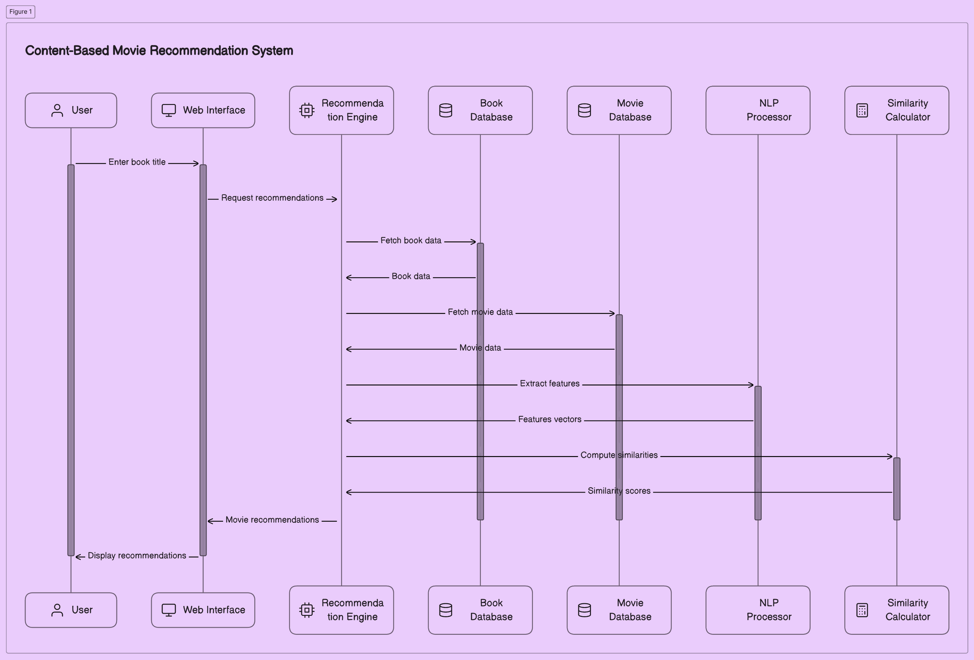

Slide 12

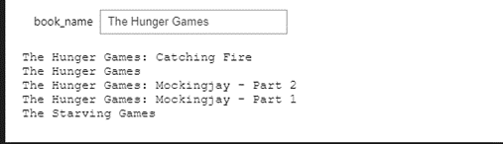

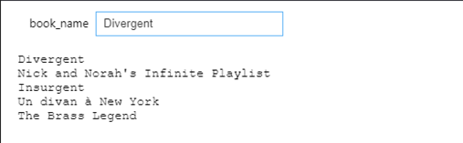
OUTPUT
HUNGER GAMES
OUTPUT
DIVERGENT

Slide 13
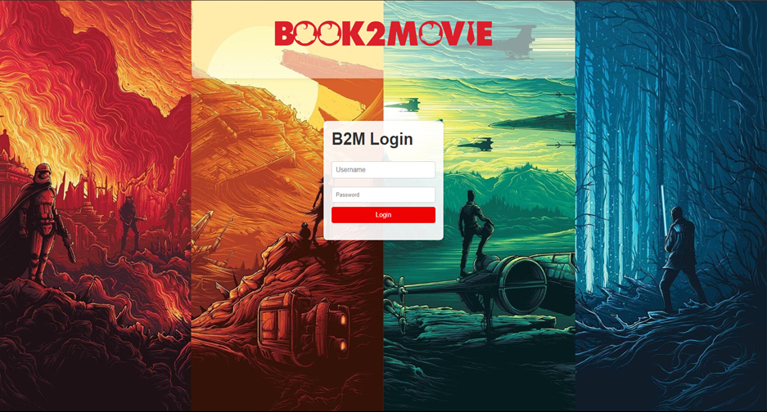

Slide 14
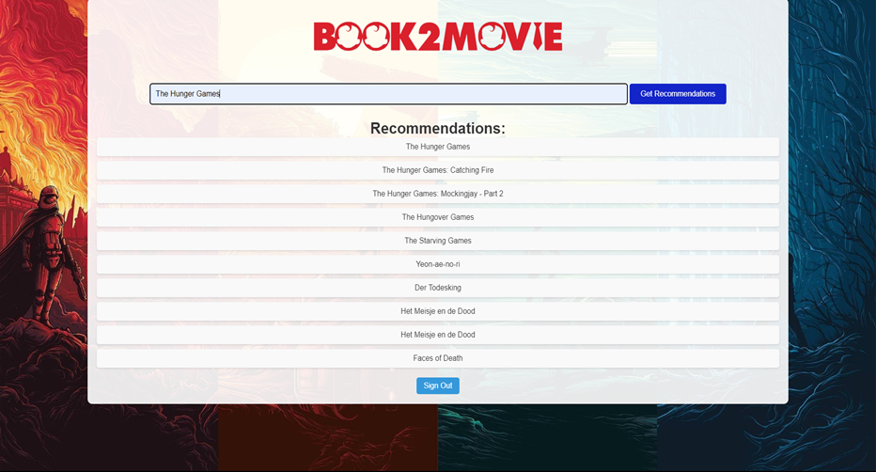

Slide 15


Akila Bala
20MIA1052
TEAM
Nithin Kodipyaka
20MIA1075

